Slide 1
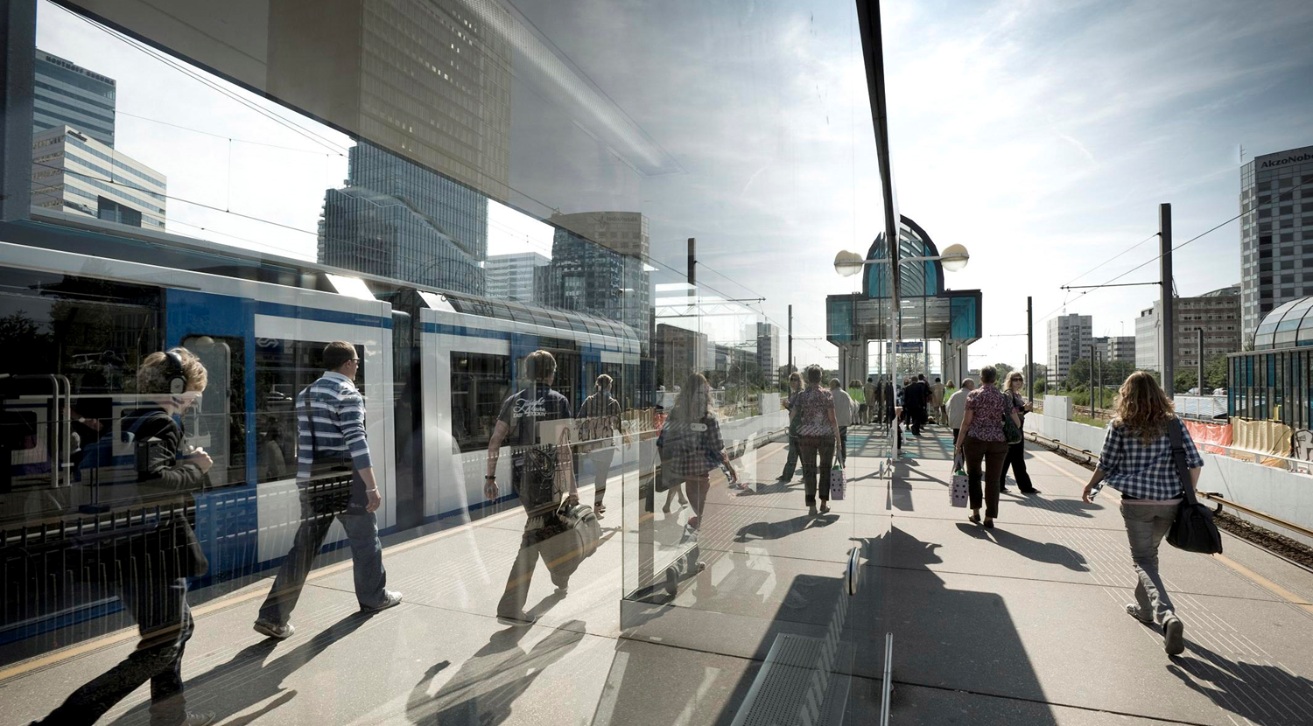
First Step to DevOps Building technical and organizational confidence through automated deployments
Mieke Deenen

Slide 2
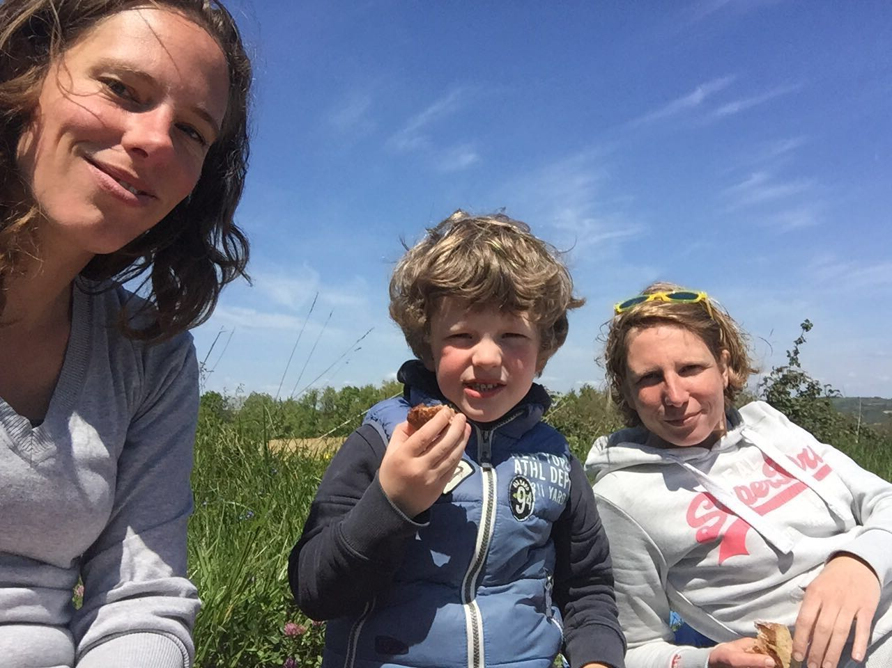
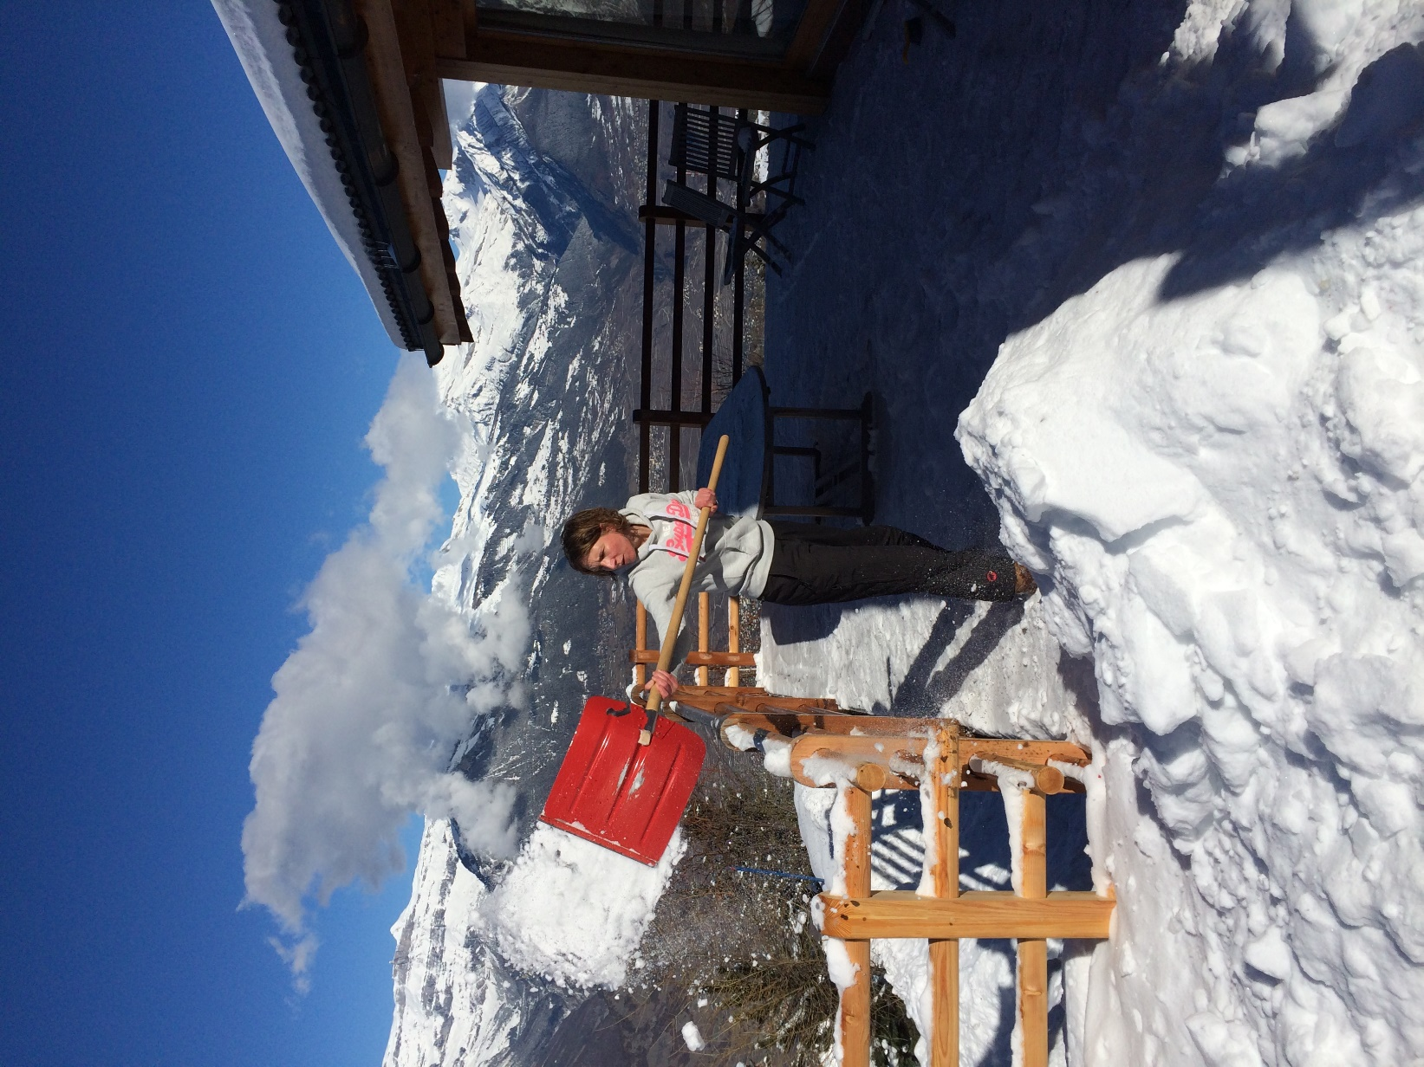
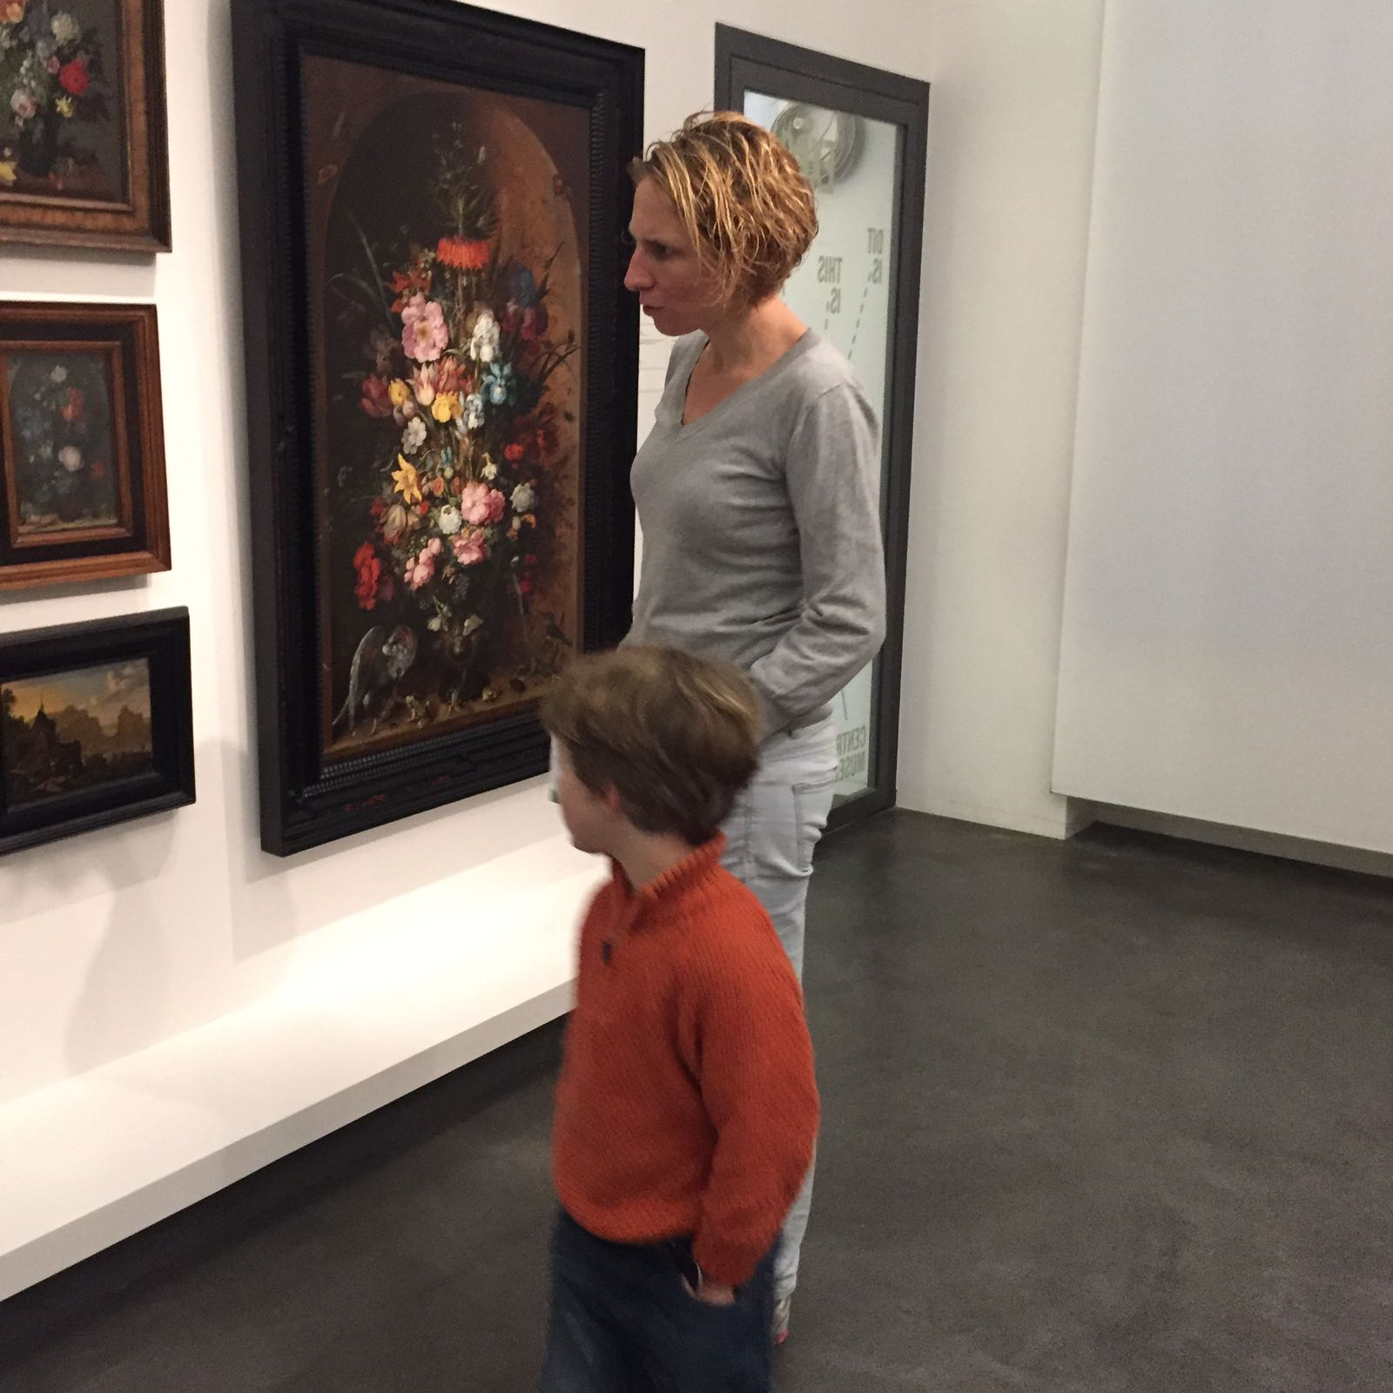
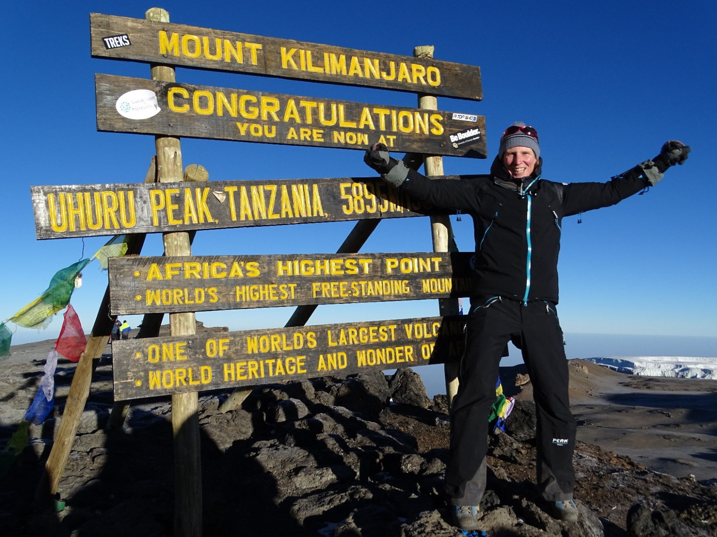
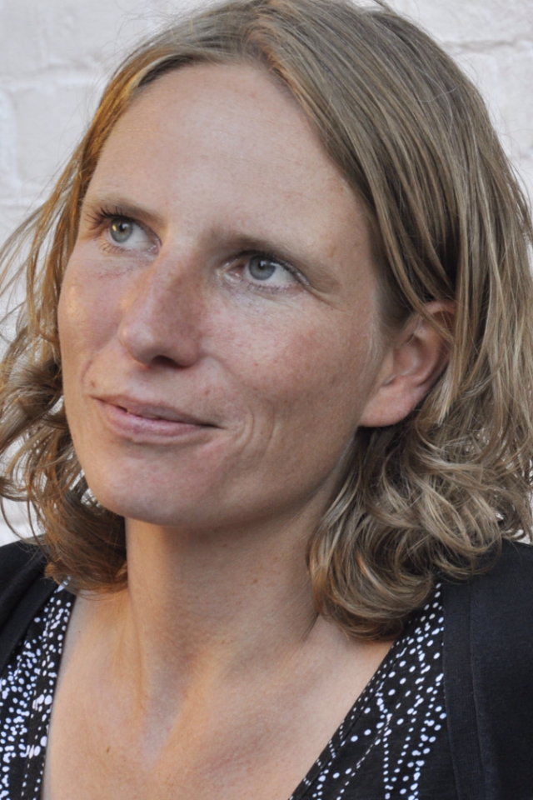
Mieke… who is she?

Slide 3

UWV
‘We offer people new prospects
for participating in work and society.’

Slide 4

Government agency
administrative authority
executing social and labour policy
social benefits
linking pin
18,000 employees
6.9 million insured people
1.4 million
benefit recipients
Government, employers, employees, tax agency

Slide 5
UWV from a social perspective
Vulnerable target group: Our customers are not our customers because they want to be. They have no choice.
People rely on our benefits to live and participate in society.
When we fail with our core tasks, the consequences are huge and guaranteed national news.

Slide 6
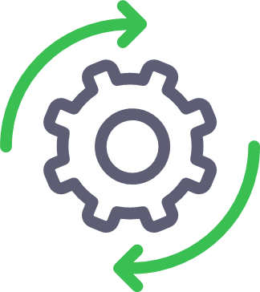
UWV from an IT perspective
Complex architecture
Most visited government website in NL
Development oursourced
Hosting and operations outsourced
Process-oriented
Risk-averse
Main KPI’s: Stability, Availability and Performance

Slide 7
2012: Need for change
Due to new legislation, we had to digitalize all our services in a very short time.
Refactoring www.werk.nl - the main site for our customers who want to find work or receive unemployment benefits:
from static to a dynamic website
new self service functionality (mandatory)
a major increase of usage.
Result:
Warning from external auditors: website is not future proof…

Slide 8
2013: Improve our site
Implement the results from the audit:
→ All effort was put to increase stability of www.werk.nl
Nonetheless, we suffered a major crash and unavailability.
Also that year, first unsuccesfull attempt to automate deployments.
Result:
Tightening the change process

Slide 9
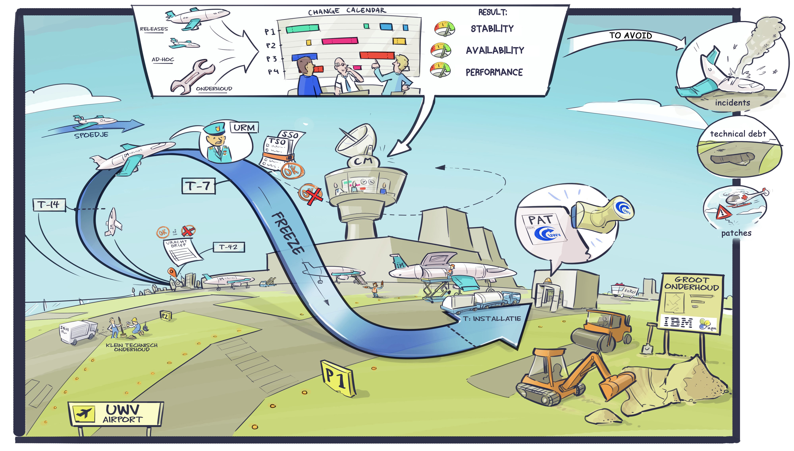
Our change proces

Slide 10
Results of further tightening the process
Process:
More quality gates, more difficult to pass the process
Hard to release anything
Stability:
Technical debt, failures
Major releases with more dependencies
Business:
Increased costs of operations
Harder to fulfill our tasks
Less opportunity to innovate
Culture:
Low trust in change or innovation
Low trust in suppliers – blame culture

Slide 11
How Can We...?
Increase quality and availability of our core applications…?
Provide new functionality for our customers on a regular basis in a predictable way without downtime...?

Slide 12
Can we do DevOps…!?

Slide 13
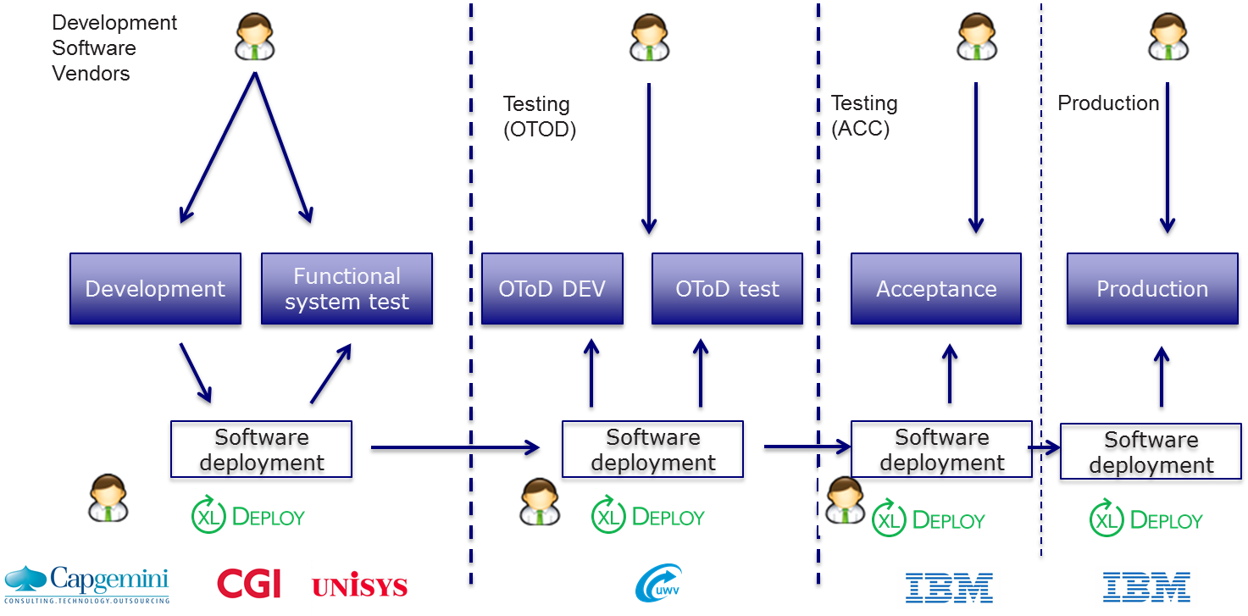
1st step: PoC Deployment Automation
1 small application with low impact
Result:
Successful Technical Proof

Slide 14
Start real DevOps project
Requirements before start
Write Project Initiation Document (PID)
Business Case (BC) – Benefits vs Costs
Approval executive board of PID and BC
Goal
30 applications, 1 division
Start of our DevOps journey with Deployment Automation

Slide 15
Challenges: DevOps project
Standard DevOps challenges
Executive support
Legacy systems
Culture
Manual to automation
UWV Enterprise DevOps challenges
Siloed tools and people: 3rd parties for Development and Hosting
Agile values within a traditional waterfall organization
Risk-averse, slow change process
Ask hosting partner to help automate his own work (billable hours)
Find the balance between the old and the new world
Skepticism, low trust, no belief

Slide 16
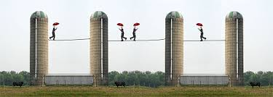
Challenge 1: SiIoed tools and people
Three siloes: Contracted software developers, ourselves with test environments + hosting company for acceptance and production environment
Response: Remove the walls

Slide 17
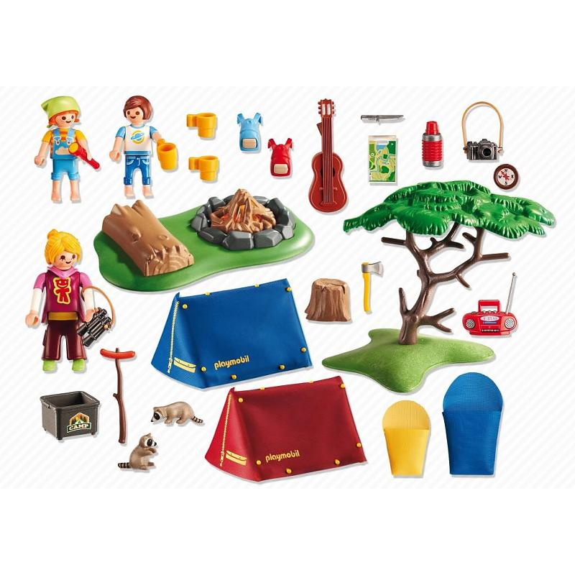

Challenge 2:
Agile values in traditional waterfall organization
Response: Campfire culture

Slide 18
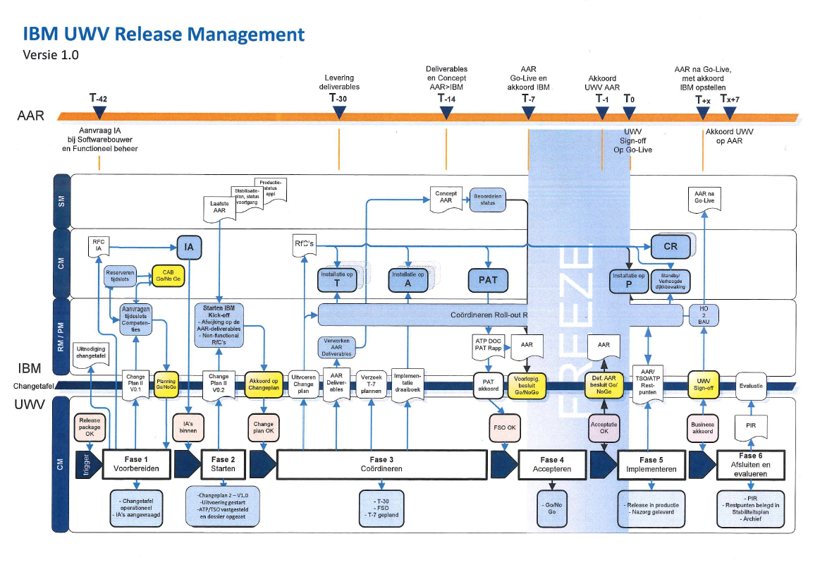
Challenge 3:
Risk-averse, slow change process
Response: Negotiate. Learn the rules, bend the rules.

Slide 19
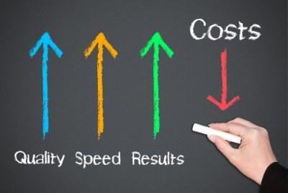
Challenge 4: Ask hosting partner to help automate his own work (billable hours)
Response: Make hosting company become a partner instead of a supplier. Create mutual goal to deliver quality, speed, results.

Slide 20
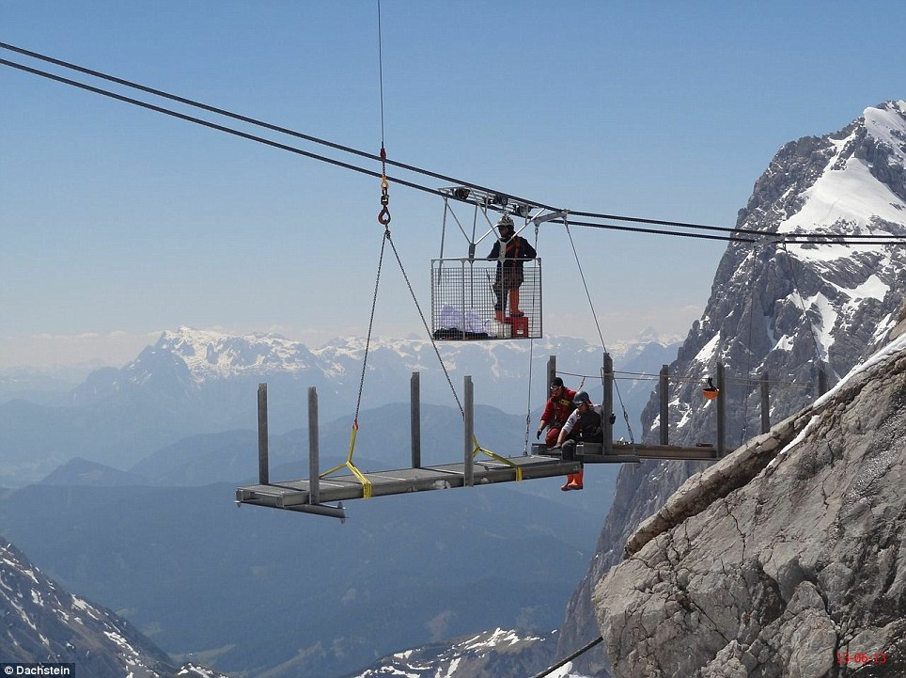
Challenge 5: Find the balance between the old and the new world
Response: Build a bridge for the old world to reach the future

Slide 21
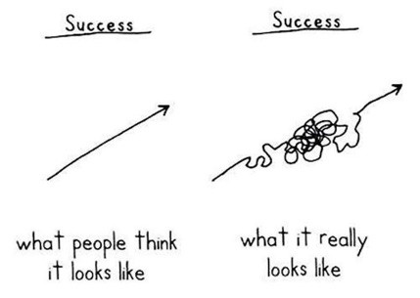
Challenge 6: Skepticism, low trust, no belief
Response: Visualize your goal and keep that in mind

Slide 22
Almost there…
After 6 months’ struggle with process and impediments, we could finally deploy to our Acceptance environment.
Now… how to get to Production!?
Notes:
.

Slide 23
Work hard in silence,
let success make the noise.

Slide 24
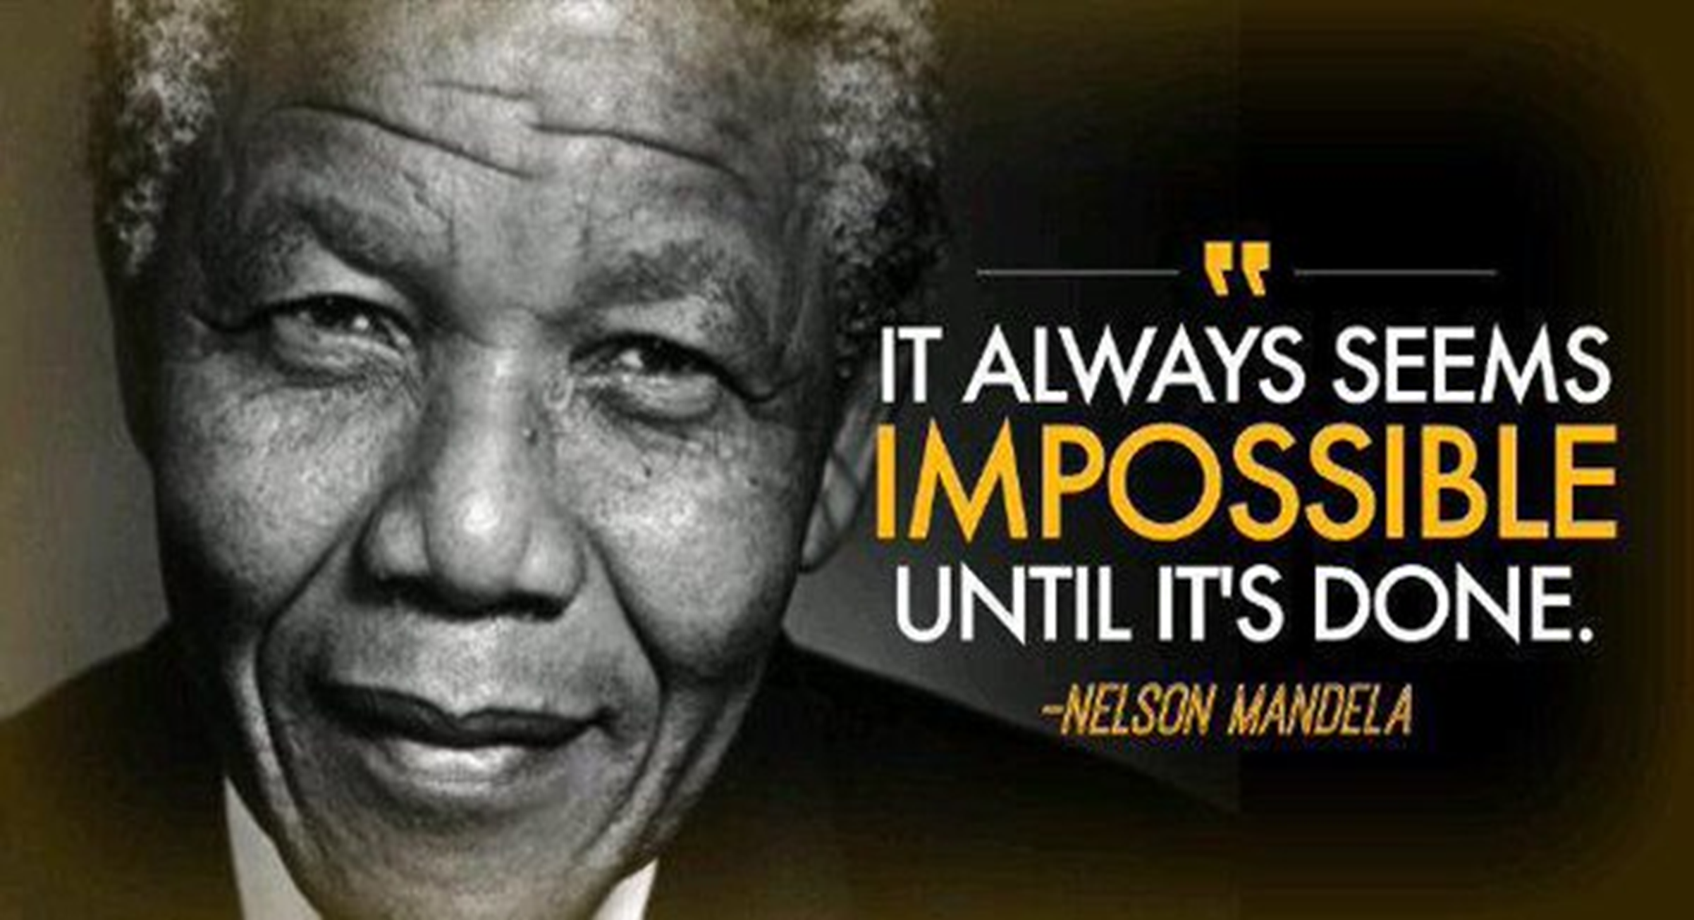
Summer 2016
From 1 to 30 applications

Slide 25
Results
Improved quality and stability
Over-achieved financial benefits
From 2/3 releases per year to bi-weekly
Low trust to high trust

Slide 26
Technical vs organizational confidence
Deployment Automation
Organizational Confidence

Slide 27
Road in front of us
Automated Deployment becomes corporate policy
Scale from 30 to 300 applications
Innovation: new technologies
Accelerate: create flow
Build a factory for deployment automation
Adjust change process
Identify waste and improve every day

Slide 28
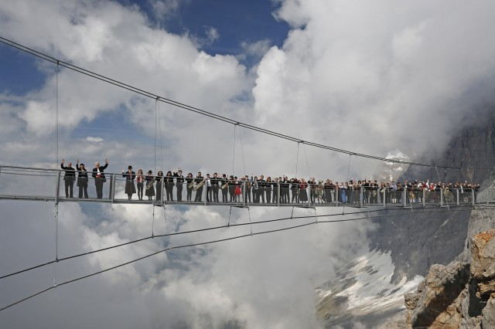
Finish the bridge – pave the road for DevOps!

Slide 29
Our advice
Create a cross-functional team with motivated and skilled members
Dare to be an island. Create DevOps values and use DevOps techniques even if your organization isn’t ready to call it DevOps yet.
No innovation without resistance – visualize your goal and have patience in working through the impediments.
Build trust, create bridges
Keep learning and improving and create flow
Look for opportunities and just do it
Celebrate your success and do it again!

Slide 30

Questions?
Contact details:
Mieke Deenen
mieke@mijlpaal.nl
+31 6 26 252 132

